Slide 2
Demand Management
Microsoft Project 2010 Ignite

Slide 3
Agenda
Overview of Demand Management
Components
Enterprise Project Types
Project Workflows
Stages and Phases
Project Detail Pages
Approvals
Steps to Implement

Slide 4
Overview of Demand Management

Slide 5

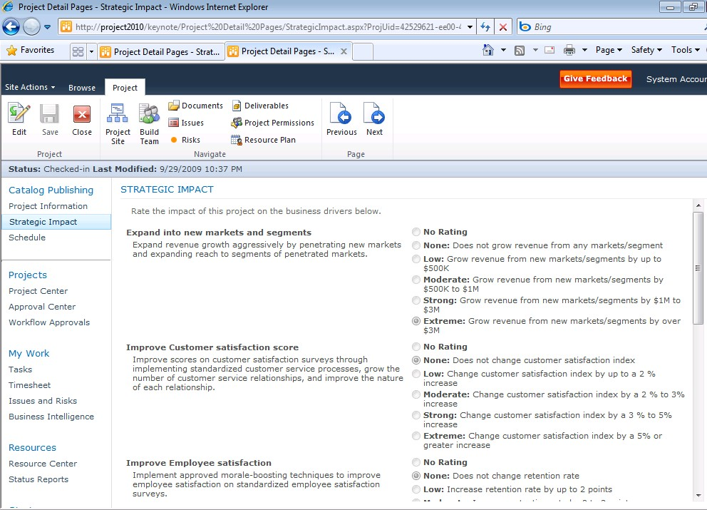





Unified Project and Portfolio Management Capture all work in a central repository
Capture all Requests
Control via Workflow
Build Business Case
IT Project Workflow
Work Request Workflow
Business Project Workflow
Strategic Impact Assessment

Slide 6

What is Demand Management?
Part of the overall Project Server 2010 solution
Part of providing a common user experience across PPM lifecycle
You can capture all work proposals in one single place
Workflows are a component of Demand Management which you can use to automate your existing business processes –optional, not required
You can create customized workflows as well as pages for displaying and collecting information from the end users
Workflows, along with other key concepts, are captured and integrated within the demand management feature set

Slide 7



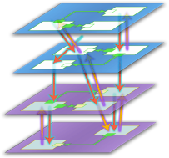







Microsoft EPM Solution Sample Phases of a Project Lifecycle
Enterprise Project Management
Create
Select
Plan
Manage
Demand Management
Portfolio Selection
Work Planning
Collaboration & Reporting
NOTE: Phases are custom tailored to the business needs, drivers, and governance

Slide 8
End User Experience
Simple to use
Information collected in stages
Information split into convenient sections/links
User Interface similar to SharePoint
Can create proposals without schedule !
Powerful and flexible
One place to enter various types of work
Enhanced support for templates
Ability to track initiatives from start to end
Align demand requests with strategy
Standardized deployment, maintenance

Slide 9
Demand Management
Capturing all “demand” (i.e. work proposals) in one single place
Making decisions on which proposals to approve and track progress
Project Server 2010’s support for Demand Management is flexible:
Simple projects that don’t require approvals and workflow
Complex projects with complex lifecycles involving multi-stage approvals and workflow

Slide 10
Demand Management Concepts
Enterprise Project Types
Workflows
Stages/Phases
Project Detail Pages
SharePoint/Custom Web-parts
Enterprise Custom Fields

Slide 11
Enterprise Project Types (EPTs)

Slide 12
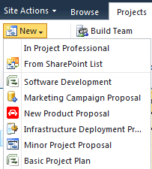
Enterprise Project Type (EPT)
Enables project creation with template schedule, workflow, and workspace
Blueprint for creating a Proposal
Groups these components:
Project Server Workflows
Project Details Page (PDP)
Stages
Phases
Project Plan Template
Project Site Template
Department
Out-of-the-Box EPTs
Sample Proposal - Workflow driven
Basic Project Plan - Non workflow driven

Slide 13
How EPT’s are used in PWA
Enables project creation with template schedule, workflow, workspace
Can be filtered by user department
PM’s create new project or proposal using an available EPT in the Project Center
Governs project and proposal lifecycle
Administrator selects “Server Settings” -> “Workflow and Project Detail Pages”-> “Enterprise Project Types” menu to manage and create EPTs

Slide 14
Enterprise Project Type (EPT)
Typically EPTs are aligned with Departments
Examples: Different sets of EPTs, some for IT, others for HR, others for Finance etc.
PWA uses EPTs to group:
Project Detail Pages
0 or 1 Workflow
Phases
Stages
Required business case artifacts
Projects created using Project Professional will automatically be associated to the default EPT
Notes:
EPT = Enterprise Project Type

Slide 15
Out-Of-the-Box EPTs
Sample Proposal
Workflow driven
Basic Project Plan
Non workflow driven
How to Create New Project Site Template:
Create New Site (Site Actions | New Site | Microsoft Project Workspace)
When Finish: Go to Site Actions | Site Settings | Save Site as Template
Go to Site Settings | Galleries | Solutions, select Solution and Activate
Leverage New Template in EPTs

Slide 16
High Level Process to Create a Custom EPT
For a Workflow EPT Design your Workflow (create your Visio Diagram)
Create the custom fields you would like to use within your workflow
Create the pages that will display your custom fields and web parts
Create the Phases of your workflow
Create the Stages that will exist within the Phases, and will hold the pages that you defined
Create the workflow in Visual Studio
Deploy the workflow onto PWA
Create an EPT and reference the workflow you just created
For a Non-workflow EPT
Create required custom fields
Create the pages you would like to show up for this EPT
Create an EPT
Select no workflow
Indicate what pages to display

Slide 17
DEMO
EPT Creation
Notes:
Click “New Enterprise Project Type” and fill in the EPT creation page
Site Workflow Association may either be “No Workflow” or a workflow that satisfies the governance requirements of this EPT
Launch PDP is selected
Department may be associated
Possible here to override PWA default EPT

Slide 18
Project Workflows

Slide 19
Project Server Workflows
Not all EPTs require workflows
Allows for a custom approval process
Workflow supports:
Simple Project Lifecycle (single stage/approval)
Complex Project Lifecycle (multi-stage/approval)
Overlaid on SharePoint Workflows
Create Custom Workflows created in Microsoft® Visual Studio® 2010 (SharePoint Designer is NOT supported)

Slide 20
Overall Project Workflow Process
EPT’s are the starting point, PM initiates a project by picking an EPT in PWA
A series of one or more Stages need to be followed in sequence. Each Stage displays one or more PDP’s to collect/display info
Phases logically group sets of Stages
A Workflow, built in Visual Studio, must be associated with at least one Stage, exerting control on the sequence through definition of Approvals
Notes:
EPT = Enteprise Project Type
PDP = Project Detail Pages
PWA = Project Web Access

Slide 21
Workflow Stages and Phases
Vital component of the Project Lifecycle
Stage controls behavior
Visible Pages
Read Only, Required Custom Fields
Phase groups stages
Current phase, stage of project available in Project Center, Reports

Slide 22
Workflow Administration
After Workflows are built in Visual Studio, they need to be packaged up as solutions or features and loaded into the PWA site using stsadm/PowerShell or VS
Refer to the Project Server 2010 SDK help file for more information
Notes:
When deploying Workflows we recommend you deploy them as SharePoint Features.
This makes things simpler and easier both when installing, and subsequent updates

Slide 23
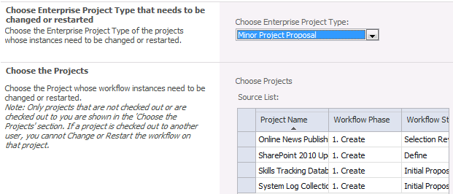
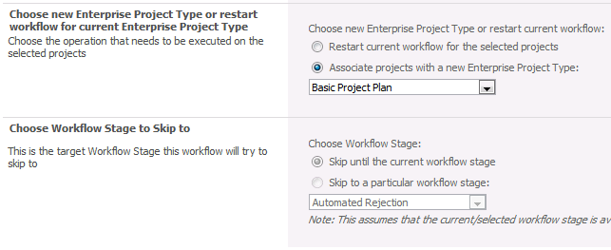
Changing an EPT mid-lifecycle
A project or proposal’s EPT may be changed in mid-lifecycle if necessary
Current workflow will end and new EPT’s workflow will begin
New EPTs pages will be loaded
Save current page’s data prior to changing EPT

Slide 24
Stages

Slide 25
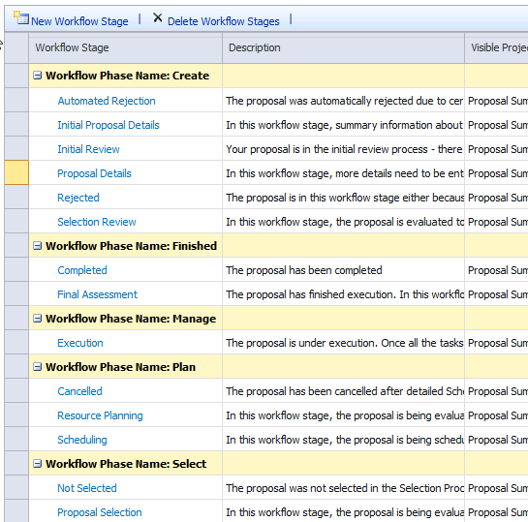
Workflow Stages
Represents one step within a project lifecycle
Appears as steps at the End-User level
Controls the behavior of:
Visible PDPs
Read-Only/Required Custom Fields
Associated Phase
Out-of-the-Box Stages

Slide 26
Phases

Slide 27

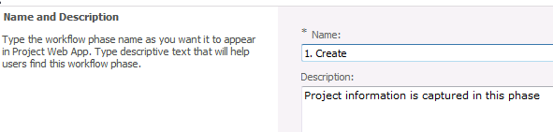

Workflow Phases
Collection of Stages grouped together to identify a common set of activities in the project life cycle
Used as a placeholder
Typically used for identification purposes
Group Stages together
Phases do not directly affect Project Detail Pages
Out-of-the-Box Phases
Create
Plan
Select
Manage
Finished
For example, A phase is like an empty file folder with a name on the tab

Slide 28
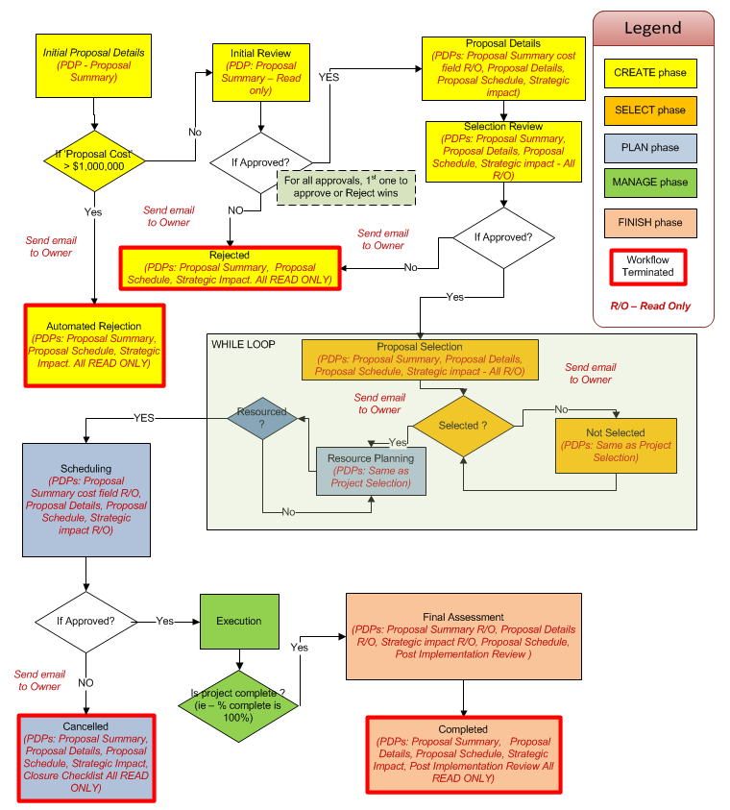
Sample Proposal Workflow
http://www.microsoft.com/showcase/en/us/details/fa81c076-a39f-4cc4-823e-60d2e23b6b44

Slide 29
OOB Sample Proposal Workflow
Custom Fields supporting OOB workflow:
Sample Approved Finish Date
Sample Approved Start Date
Sample Areas Impacted
Sample Assumptions
Sample Business Need
Sample Compliance Proposal
Sample Goals
Sample Post Implementation Review Date
Sample Post Implementation Review Notes
Sample Primary Objectives
Sample Proposal Cost
Sample Proposed Finish Date
Sample Proposed Start Date
Lookup Tables supporting OOB workflow:
Sample Areas Impacted
Sample Primary Objective

Slide 30
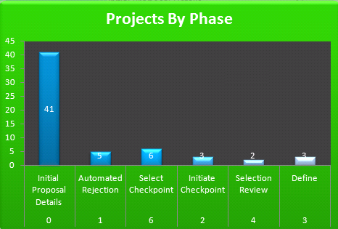
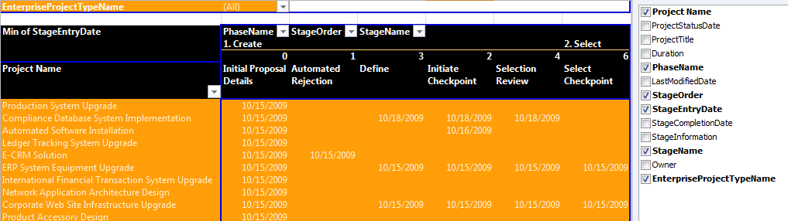
Visualizing Project Workflow
Two OOB Excel report templates are available that help you to visualize Projects as they go through workflow stages and phases:
WorkflowChart
WorkflowDrillDown

Slide 31
DEMO
Workflow Reporting

Slide 32
Project detail pages

Slide 33
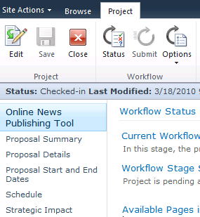
Project Details Page (PDP)
SharePoint Web Part page that is used to drive the project lifecycle
Used to input and/or view data
Can add other SharePoint Web Parts
Includes project fields
Can be reused for other Stages
Is “project” aware
Library of PDPs can be used across multiple EPTs/Stages
PDPs
Out-of-the-Box PDPs
Post-Implementation Review | Project Details | Project Information
Proposal Details | Proposal Schedule | Proposal Stage Status
Proposal Summary | Schedule | Strategic Impact

Slide 34
DEMO
PDP Creation
Notes:
PWA -> Server Settings -> Project Detail Pages ( Under the “Workflow and Project Detail Pages” heading )
Click “Documents” tab in Fluent UI
Click “New Document” and fill in page info
Click “Insert” tab , then “Web Part”
Add desired web parts to form PDP

Slide 35
Approvals

Slide 36
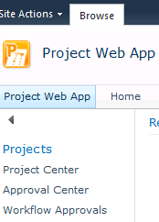
Workflow Approvals
PWA -> “Workflow Approvals” in the Approvals section of Quick Launch
The approval process allows decision-makers :
Ability to tightly control which projects continue along in their lifecycle
Provide input to people who are submitting the project proposals
Project Server Workflow Tasks
Items requiring review and approval displayed
Edit Item to comment and make an approval/rejection decision
Approver may be notified by email
“Edit this task” on the message in Outlook
Default WF approvers in PWA (security group):
Portfolio Managers

Slide 37
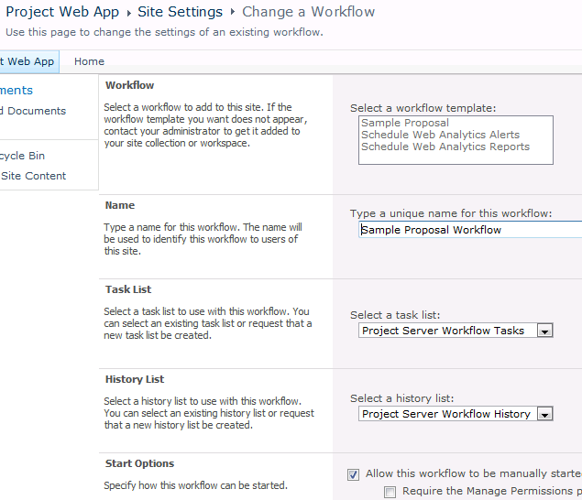
Approval Configuration
Typically approvals are placed between Stages and Phases
Stages and Phases do not necessarily have to have approvals to proceed
Approval Process is based on SharePoint Server 2010

Slide 38
Approval Configuration ctd.
Create PWA User Group for approvers
Three step process for configuration
Create a Stage for the workflow to enter, where it will wait for an approval
Place an Office Task (SharePoint workflow activity) at the beginning of the stage which will send out tasks to people in the PWA Group for approvers
Create Activities which will wait for the approvals to respond to the tasks and respond according to what the approvals decide on
Notes:
approval is accomplished by doing three tasks:
Create a Stage for the workflow to enter, where it will wait for an approval.
Place an office task at the beginning of the stage which will send out tasks to people in the Approval Group.
Create code which will wait for the approvals to respond to the tasks. And respond according to what the approvals decide on.
Note that the logic behind how approvals are handled is up to the developer. The workflow can wait for all approvals to approve, or it can wait for a majority vote, or it can wait for the first response, and so on.

Slide 39
DEMO
Approvals
Notes:
Demand Management and Workflow - walk through the project lifecycle from user (PM/Approver/Team Member) perspective – connecting the dots
Cover:
Creating the approval process for a proposal
Submitting a proposal
Approving proposals

Slide 40
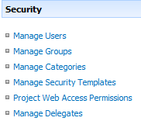
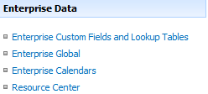
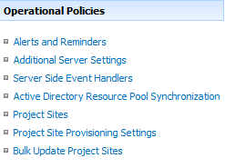
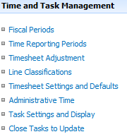
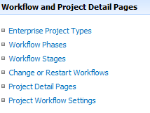
Customizations by Configuration
Available Feature Areas for Custom Configuration:

Slide 41
STEPS to IMPLEMENT

Slide 42
Step 1: Define the Project Lifecycle
Initial Proposal
Rejected
Approved
Not Selected
Cancelled
No
Yes
No
No
Proposal Detail
Selected
Resource Planning
Approved
Execution
Project Complete
Yes
Yes
Approved
Proposal Selection
Fully Resourced
Scheduling
Project Complete
Final Assessment
No
Yes
No
Yes
No
Yes

Slide 43
Step 2: Define the Workflow Phases
Create Phase
Select Phase
Plan Phase
Manage Phase
Finished Phase
Initial Proposal
Rejected
Approved
Not Selected
Cancelled
No
Yes
No
No
Proposal Detail
Selected
Resource Planning
Approved
Execution
Project Complete
Yes
Yes
Approved
Proposal Selection
Fully Resourced
Scheduling
Project Complete
Final Assessment
No
Yes
No
Yes
No
Yes
Notes:
Very important to plan the workflow correctly
Here is an example of how our workflow’s flow chart looks like

Slide 44
Step 3: Create and Configure Objects In Project Web App
Custom Fields (Project/Task/Resources)
Phases
Stages
Project Detail Pages
Project Plan Template*
Project Site Template*
Enterprise Project Type (EPT)
* Optional
Notes:
Create the objects in Project Server
Need to create the above 5 objects

Slide 45

Step 4: Create Workflow in Visual Studio Requirements to create Project Server Workflows
Visual Studio 2010
Must be installed on the same box as Project Server
Administrative rights on:
Server
SharePoint farm
Leverage Project and SharePoint API and Services (InfoPath Services, Excel Services …)
Validate WF in Staging environment before ANY Production rollout
IMPORTANT Please refer to the MSDN SDK and webcasts for guidance/samples and Step by Step instructions on Workflow and Demand Management
Notes:
Step 3 – Create the workflow in Visual Studio requirements
Only visual studio 2010 is supported
Need to install Visual Studio on the same box as Project Server
Need to be administrator on the server box and on the farm
These are what you need to do to be able to develop a workflow, but once the workflow is developed you can port the workflow from the development box to the production box without Visual Studio on the Production box.

Slide 46
Customizations Using Developer Tools
Primarily through Custom Web Parts
Custom Web Parts participate in Project Create/Edit experience
Increasingly use SharePoint Services
Like InfoPath Services, Excel Services, Cross List Web Part
New Read/Write APIs for Demand Management
Workflow fully customizable in Visual Studio 2010

Slide 47
Demand Management Resources
Video
Project Server 2010 - Demand Management
Project Server 2010 - Demand Management Workflow Deep Dive
Walkthrough of the Out of the Box Sample Proposal Workflow
Managing the Project Life Cycle with Demand Management
MSDN/SDK
Developing Project Server Workflows

Slide 48

- Resources
Product information and trial download
http://www.microsoft.com/project
Project Team Blog http://blogs.msdn.com/project
Interactive content - Videos & Sessions & WebCasts
http://www.microsoft.com/showcase/en/US/channels/microsoftproject
http://www.microsoft.com/events/series/epm.aspx
IT Professional related
TechCenter @ TechNet http://technet.microsoft.com/ProjectServer
Admin Blog http://blogs.technet.com/projectadministration
Developer related
Developer center @ MSDN http://msdn.microsoft.com/Project
Programmability blog http://blogs.msdn.com/project_programmability
Additional questions? Project 2010 Forums!
http://social.msdn.microsoft.com/Forums/en-US/category/projectserver2010,projectprofessional2010
SharePoint 2010
http://sharepoint.microsoft.com
FORUMS
Project Professional 2010
General Questions and Answers
Project Server 2010
General Questions and Answers
Setup, Upgrade, Administration and Operation
Customization and Programming

Slide 49
Summary
Project Server 2010’s Demand Management:
Supports Work Management and governance
Unifies project and portfolio management
Flexible and extensible
Build on SharePoint Server 2010

Slide 50

© 2009 Microsoft Corporation. All rights reserved. Microsoft, Windows, Windows Vista and other product names are or may be registered trademarks and/or trademarks in the U.S. and/or other countries.
The information herein is for informational purposes only and represents the current view of Microsoft Corporation as of the date of this presentation. Because Microsoft must respond to changing market conditions, it should not be interpreted to be a commitment on the part of Microsoft, and Microsoft cannot guarantee the accuracy of any information provided after the date of this presentation. MICROSOFT MAKES NO WARRANTIES, EXPRESS, IMPLIED OR STATUTORY, AS TO THE INFORMATION IN THIS PRESENTATION.

